Slide 1

Image

Slide 2
Project Associates
Guide:
Mrs. Ranjini S.
Team: USN
Harish Patil 2BV09IS034
Pavankumar B. L. 2BV09IS062
Pradeep C. 2BV09IS067
Priyanka Patil 2BV09IS075

Slide 3
CONTENTS
Existing System
Motivation
Problem Definition
Activity Diagram
Functional Requirements
Non-Functional Requirements
Screen Shots
Subject Relevance
Learning Tools
Conclusion

Slide 4
Existing System
In the past video game industries were booming exponentially. But with the success rate of personal computers and mobile phones the online gaming websites and applications have become a hit. Earlier games were just for entertainment, to pass the time or to just relax the mind. But with the world being so competitive the cliché of entertainment in games has turned to learning. People tend to learn through games. People tend to learn in every moment. We believe in learning throughout the life. There are so many gaming applications which provide entertainment. But there are very few applications which provide knowledge through entertainment. This application is one among them.

Slide 5
MOTIVATION
The importance of logical reasoning and practical analysis.
To learn building the applications for Windows operating system.
To overcome the competition between mobile OS efficient and useful applications are necessary.

Slide 6
PROBLEM DEFINITION
To develop a game application which will push the user’s intelligent level to its best. Different levels of puzzles are taken with interesting constraints imposed on the user. And will challenge the user to answer the questions to reach the final goal.

Slide 7
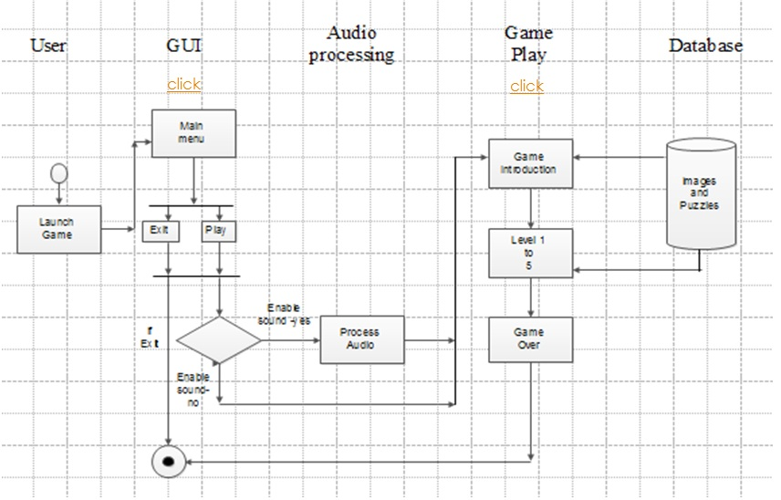
ACTIVITY DIAGRAM

Slide 8
FUNCTIONAL REQUIREMENTS
At the start of the application, the main menu page shall be displayed.
The main menu shall consist of 2 buttons, PLAY and EXIT.
At the click of PLAY button, the user shall be given an option to enable or disable the sound of the application.
If the user enables sound then background audio shall be played using background audio player agent.
After enabling/disabling of the sound the application shall be navigated to the next page.

Slide 9
FUNCTIONAL REQUIREMENTS[contd.]
The next page of the application shall introduce the story to the user.
In this application .gif shall be used to enable the animation and the motion of the images.
During gameplay different set and type of questions shall be displayed on screen and answers shall be validated before proceeding to next step.
Different set and type of questions and all the solutions shall be stored in an isolated file storage medium i.e. mobile’s flash memory.
At a different level of game suitable type of question must be fetched from file and displayed on screen.

Slide 10
NON-FUNCTIONAL REQUIREMENTS
Our app requires maximum of 15 Mb memory.
Reliability- This app runs 99% of the times.
Response time- This app’s response time is 0.5 seconds.
Speed- Depends on the mobile’s main memory.
Portability- Meets out all the requirements of the customer.
Performance- The performance is better if the user downloads the app properly.

Slide 11

SCREEN-SHOTS
Introduction Page

Slide 12
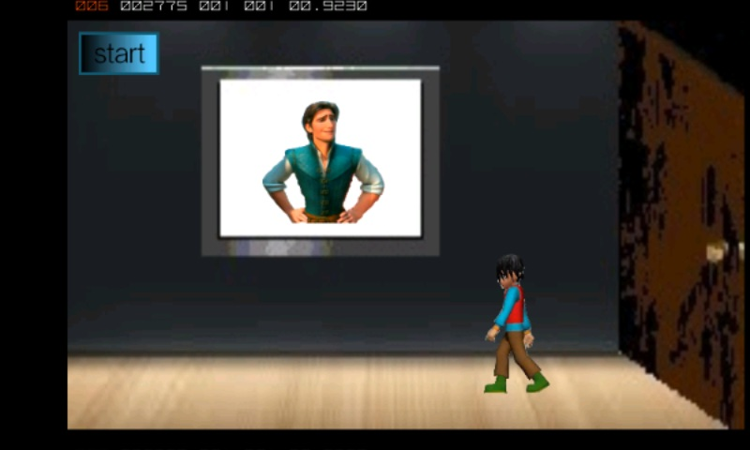
Introduction of the Game

Slide 13
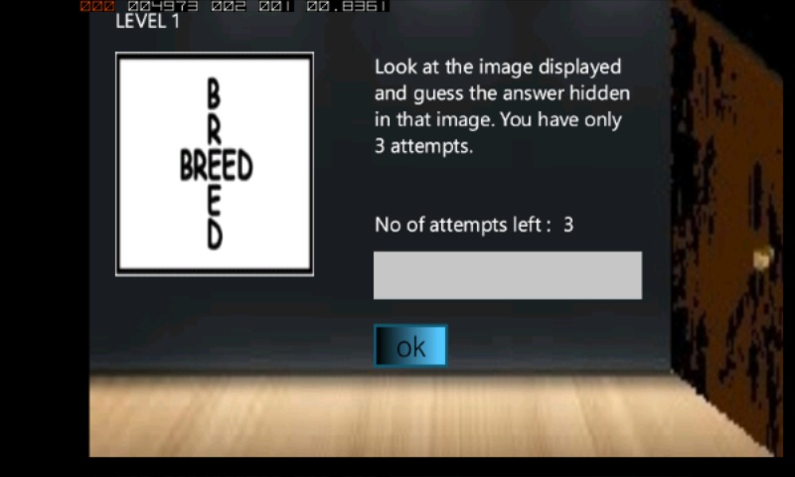
Beginning of Level-1

Slide 14
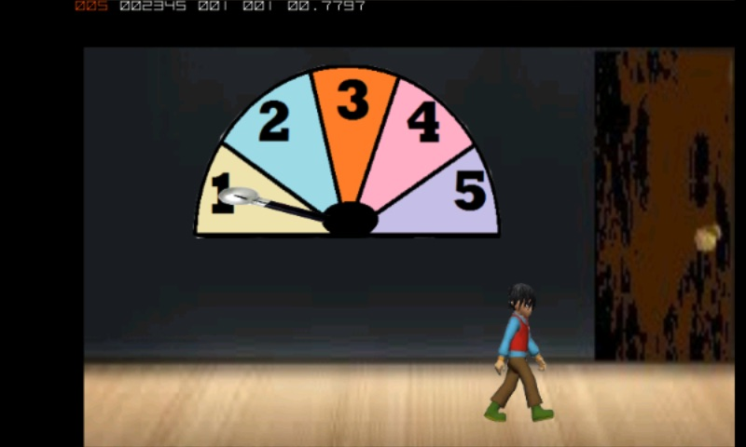
End of Level-1

Slide 15
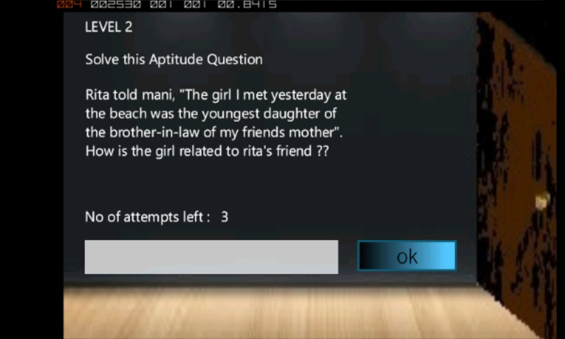
Beginning of Level-2

Slide 16
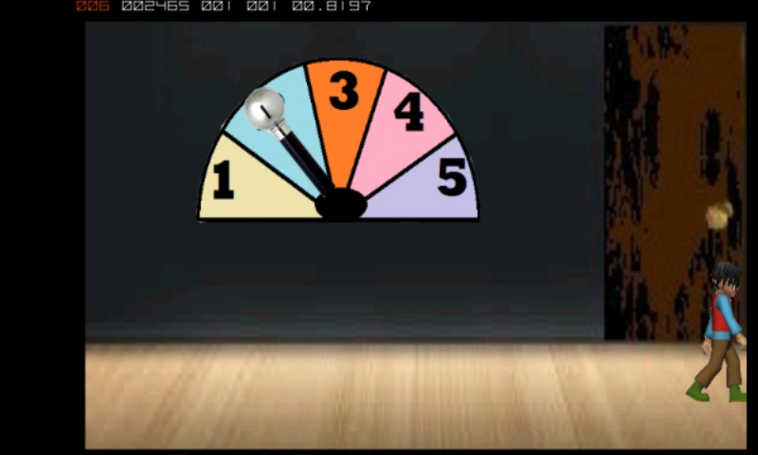
End of Level-1

Slide 17
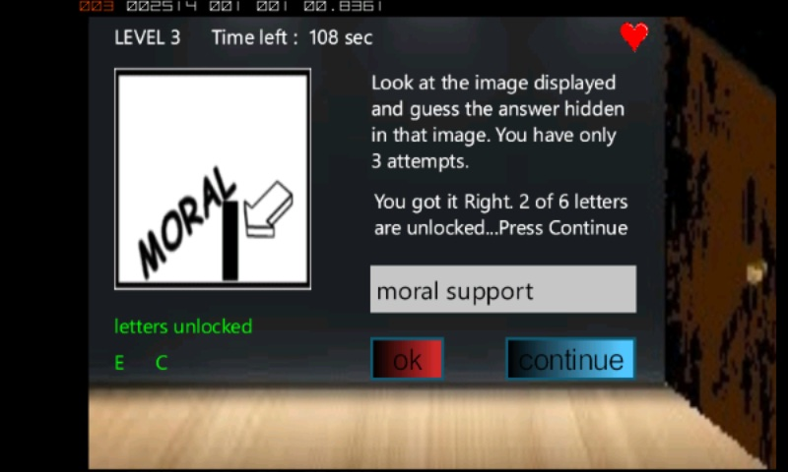
Beginning of Level-3

Slide 18
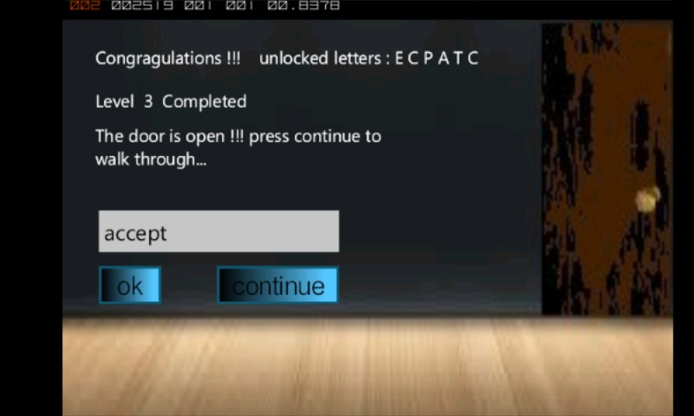
Unlocking the password in Level-3

Slide 19
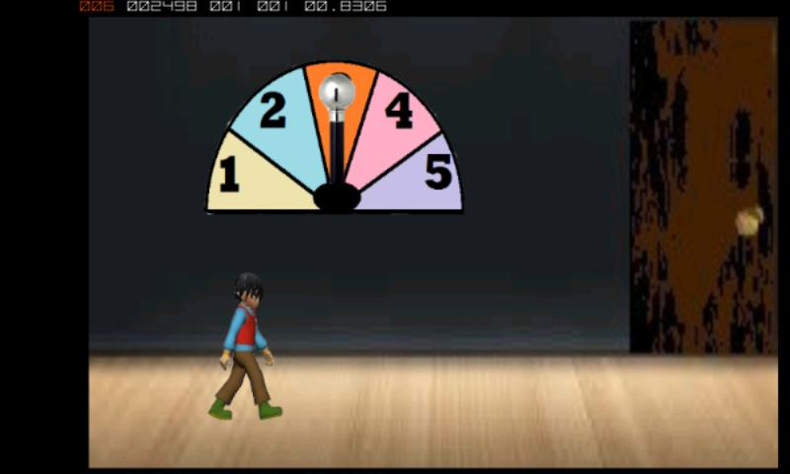
End of Level-3

Slide 20
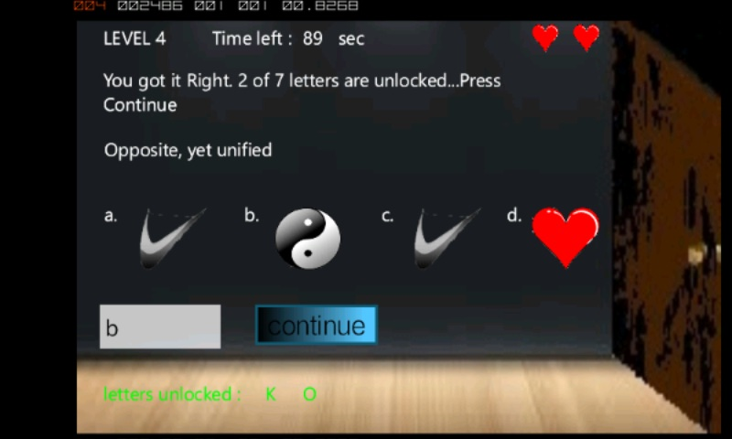
Level-4 questions

Slide 21
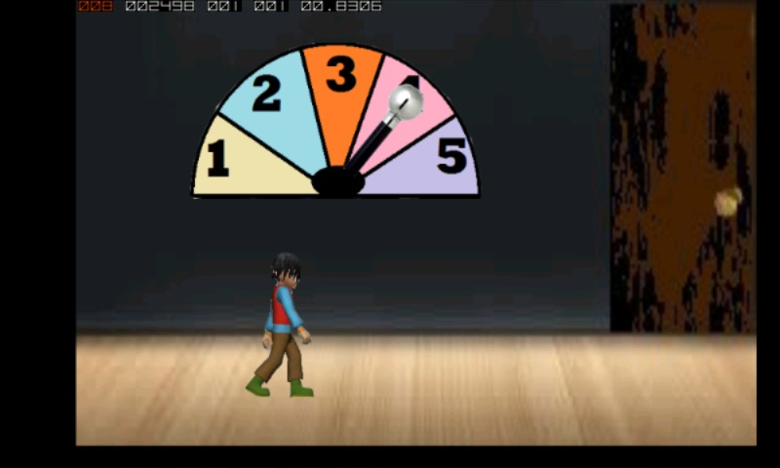
End of Level-4

Slide 22
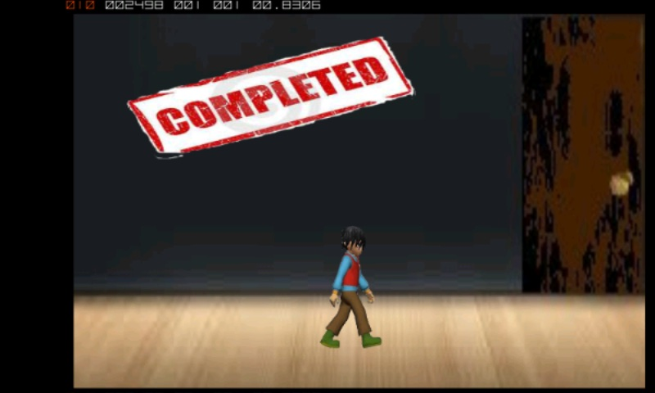
After crossing all the Doors

Slide 23
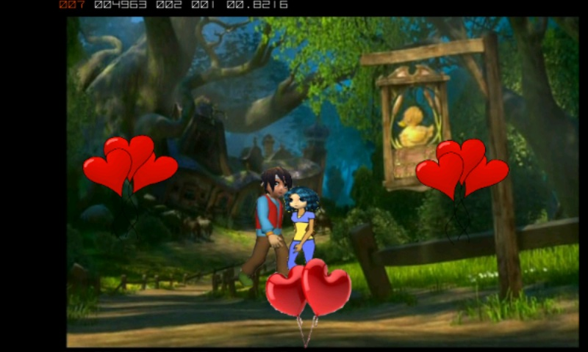
Climax of the game

Slide 24
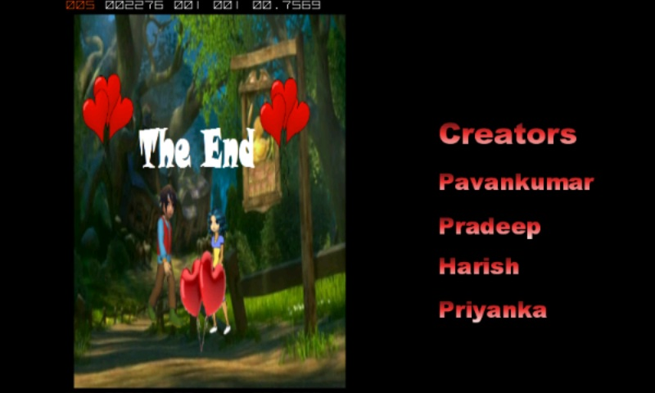
Credits-i

Slide 25
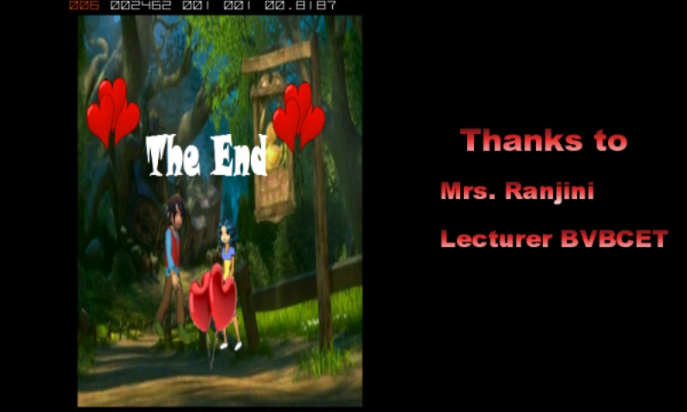
Credits-ii

Slide 26
SUBJECT RELEVANCE
Programming Language is C#
Design and Analysis of Algorithm
Operating System
Fundamentals of Software Engineering

Slide 27
LEARNABILITY AND TOOLS
Design : E-Draw Tool
Implementation : Visual Studio 2010 Express for windows 7
Mini Project Report : MikTeX Tool

Slide 28
CONCLUSION
With a large and growing user base that generates large revenues but also raises numerous technological applications, Mobile Games have recently started to attract the interest of the research community. In this work we have tried to identify the availability of the puzzle-based games in Windows phone Operating System. To address this, we have designed and implemented “Mystery Doors”, a puzzle-based gaming application for Windows phone. Our architecture focuses on puzzle game, which is one of the most important components of the generic game.

Slide 29
THANK YOU…

